Slide 1
Project 03
Group 02
Phillip Charles, Jasmine Kim, Ryan Mohamed, Sean Ogle, Samiha Aktar, Oliver Vidal

Slide 2
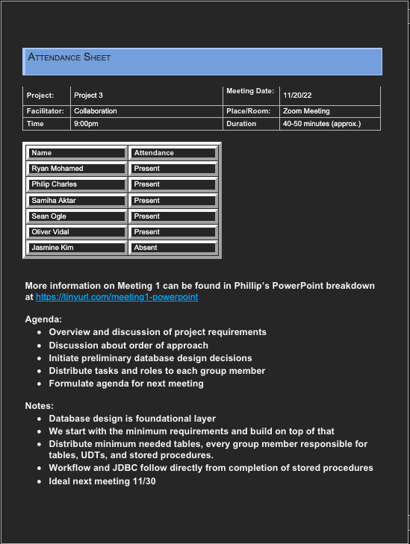
Project Tracking
Meeting 01 (Zoom 11/20/22)
40-50m breakdown of project requirements
Discussion about order of approach
Assignment of preliminary tables and procedures for each member
Designate responsibilities
Goals for next meeting on 11/30
Meeting 01
Meeting 02
Meeting 02 (Zoom 12/04/22)
Initial date canceled, replaced with group update in Discord
Evaluation and testing of current progress on SMSS
Discuss remaining and final steps expected from each member
CDM vs LDM vs FDM
Consensus about the week's timeline

Slide 3
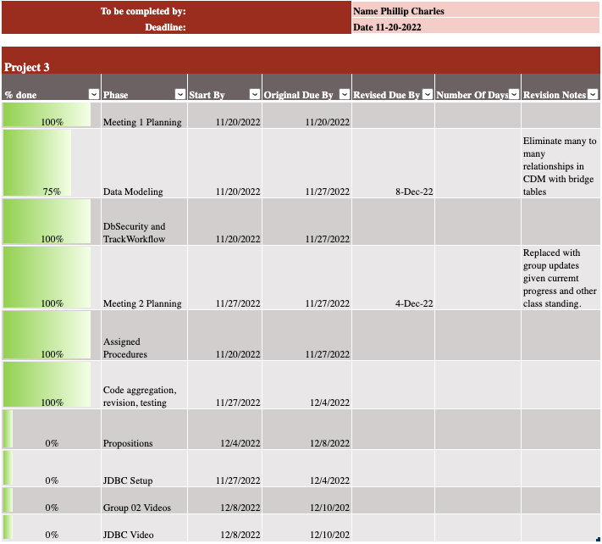
To-do List
To-do
Individual task tracking
Individual updates made at each members leisure and availability
Central ground for project manager to gauge high level progress in Gantt chart
Eases need for scheduled communication
Reduces mental weight of each group members need to recall every project deliverable

Slide 4
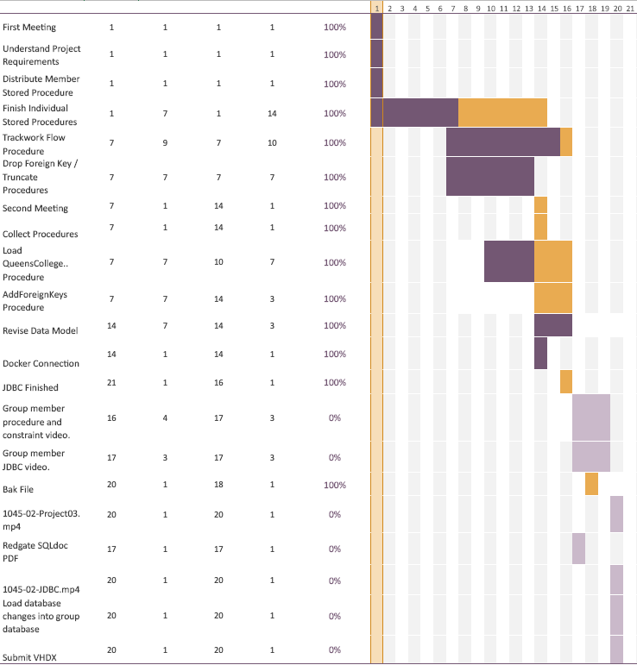
Project Planner (Gantt)
High level overview of group tasks
General consensus of group progress towards final goal
Order of execution / priority instantly interpreted
Delays initially considered at start of schedule
Benefits of start 1 week earlier than before are also visually represented (graph would be much more condensed causing concern)
Gantt

Slide 5
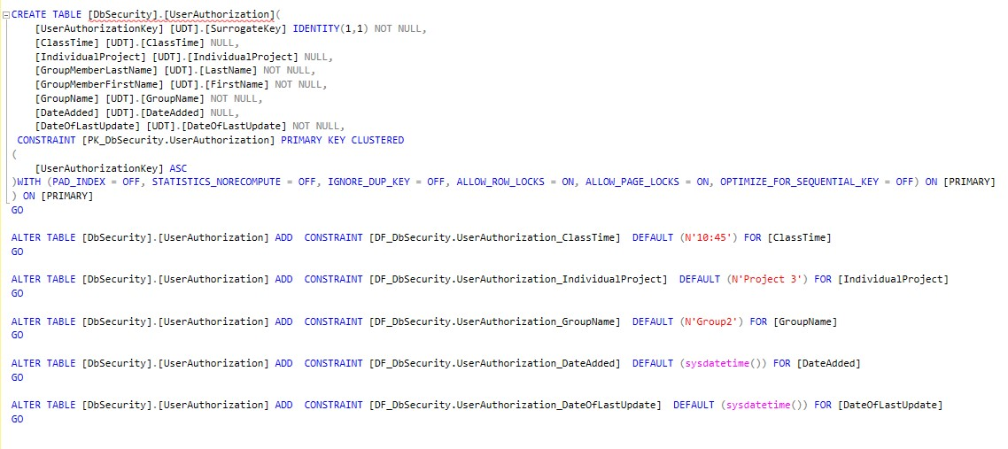
Authorization Table

Slide 6
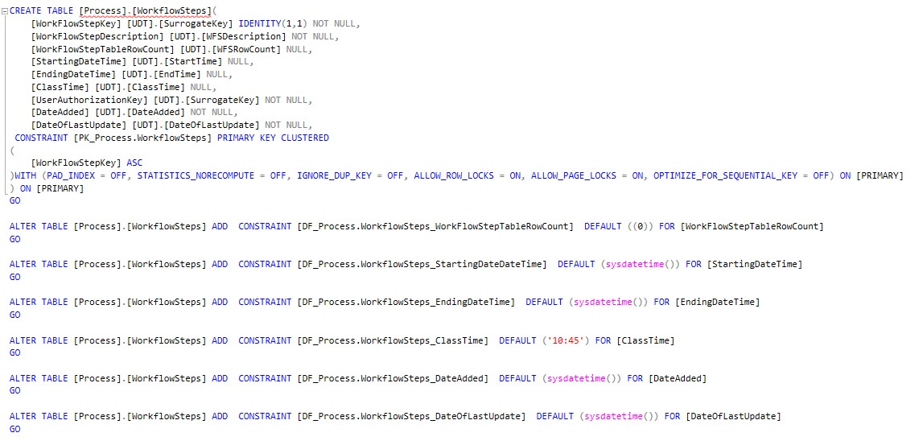
WorkFlow Table

Slide 7
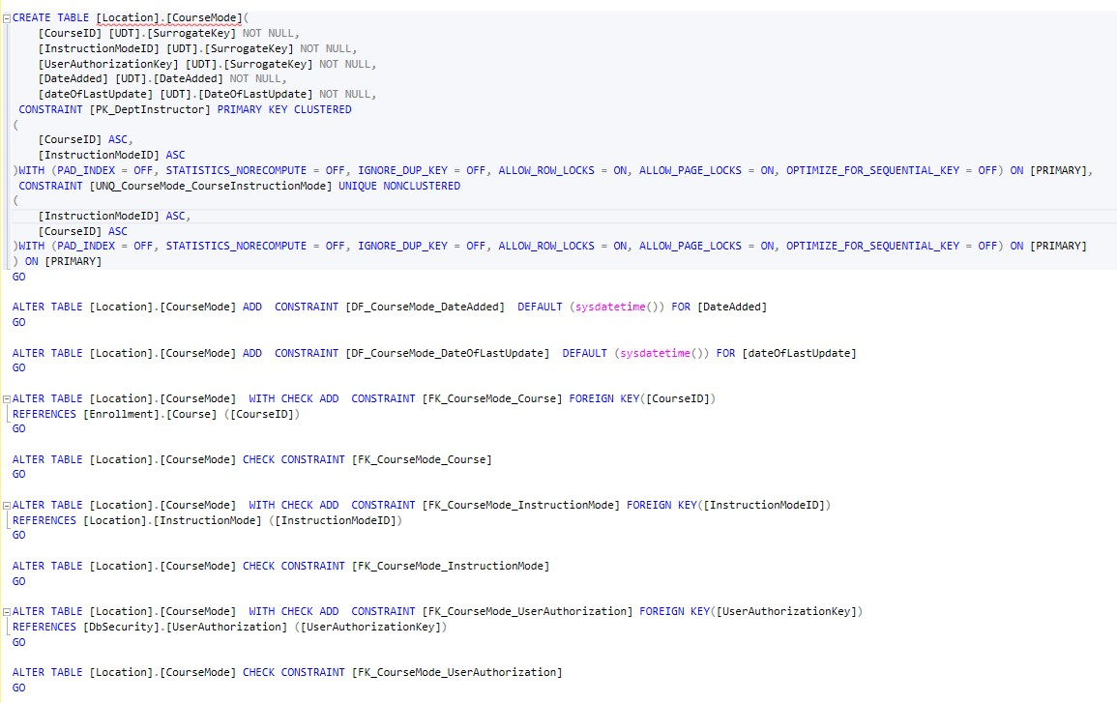
Course/Mode Bridge Table

Slide 8
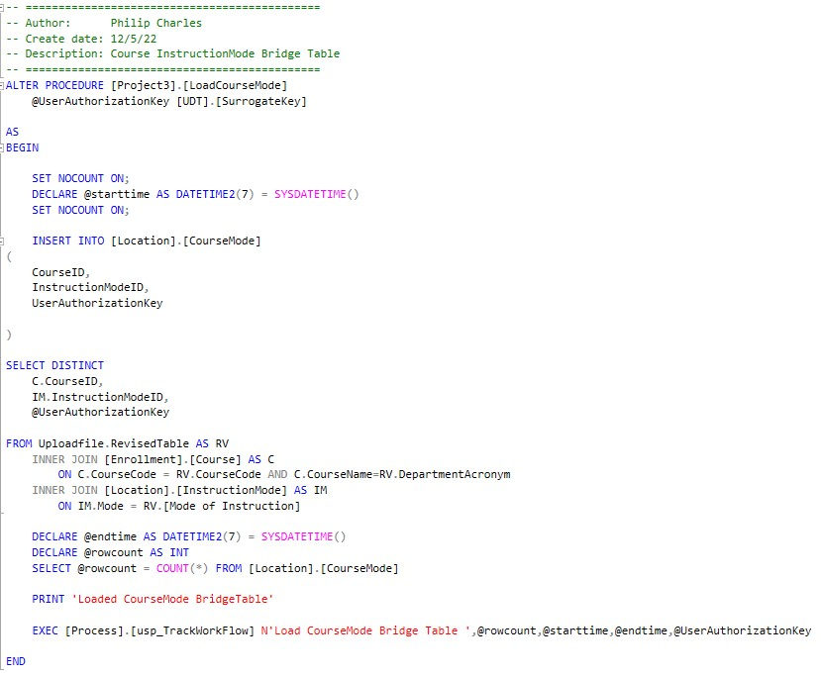
Course/InstructorMode Bridge Procedure

Slide 9
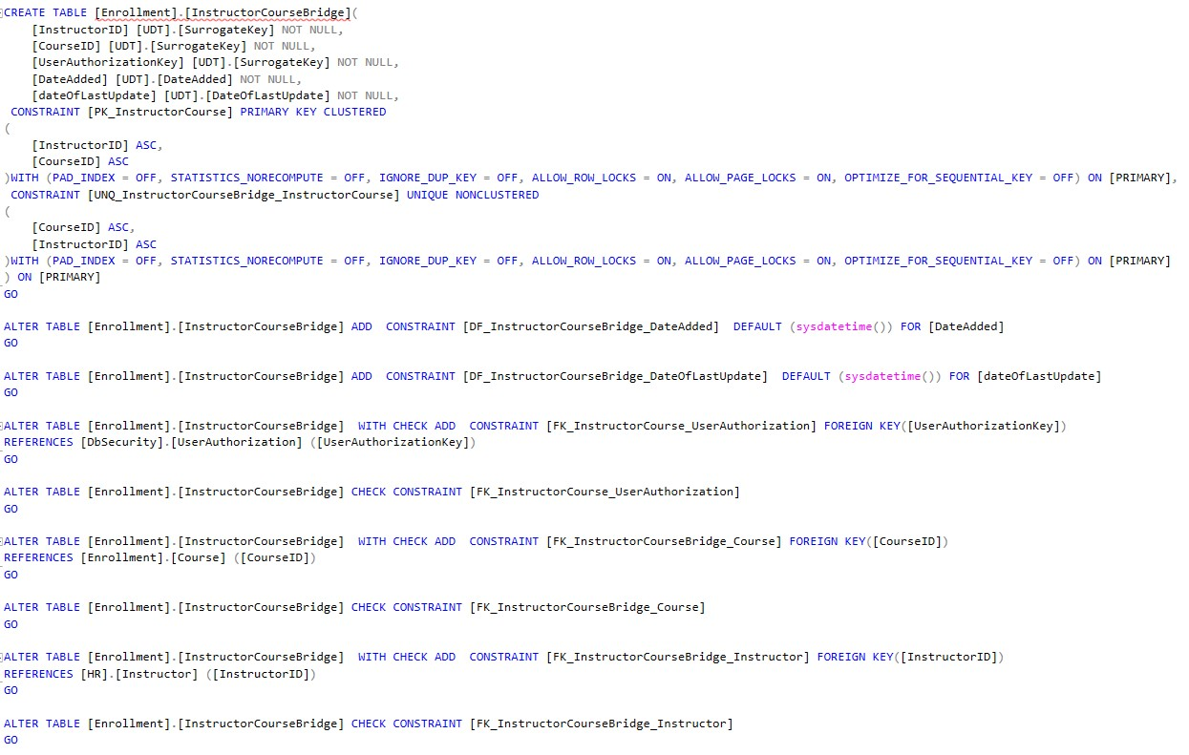
Instructor/Course Bridge

Slide 10
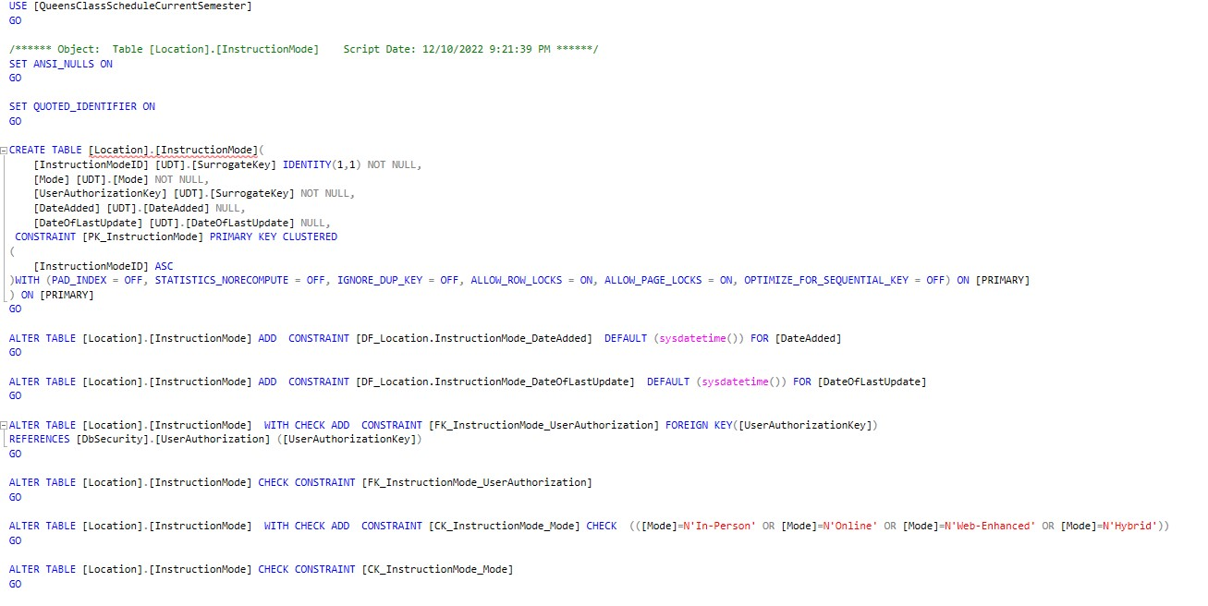
InstructionMode Table

Slide 11
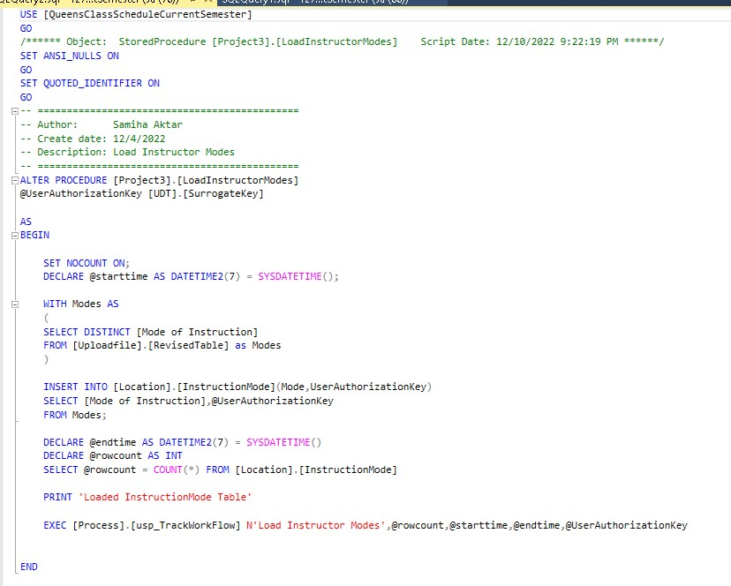
InstructionMode Procedure

Slide 12
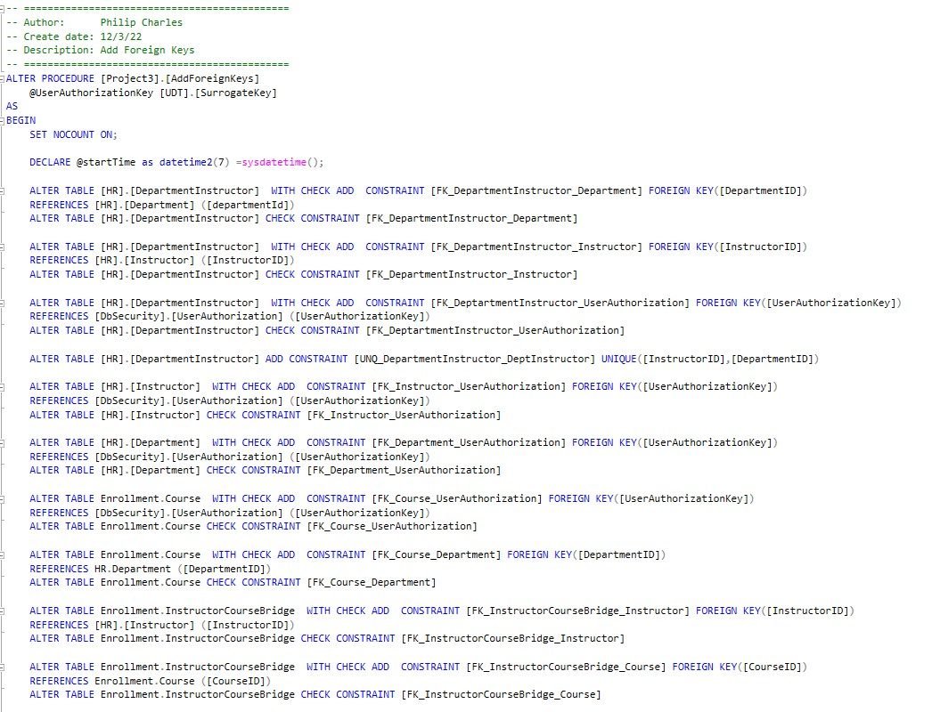
Add ForeignKeys

Slide 13
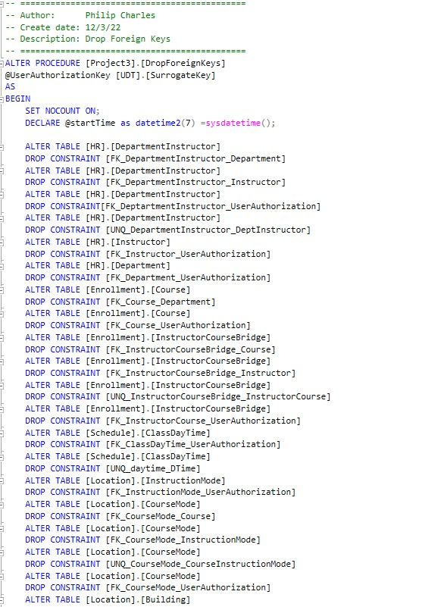
Drop ForeignKeys

Slide 14
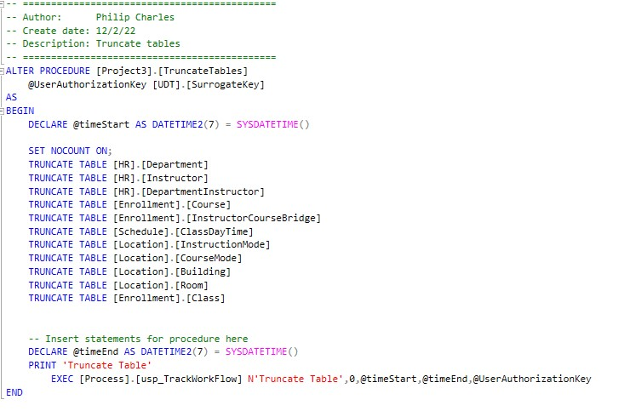
Truncate Tables

Slide 15
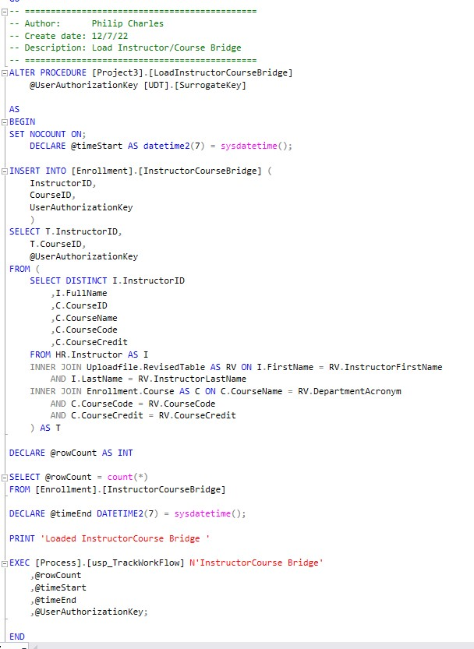
Instructor/Course Bridge Procedure

Slide 16
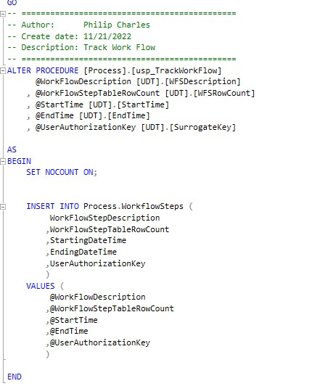
TrackWorkFlow

Slide 17
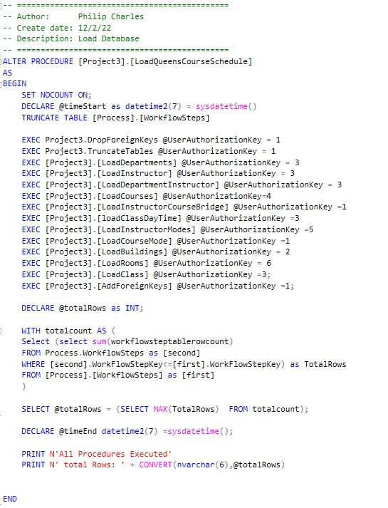
LoadQueensCourseSchedule

Slide 18
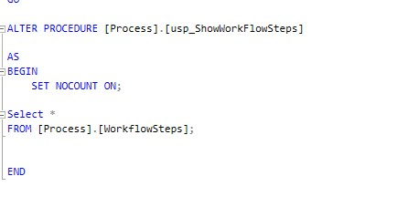
ShowWorkFlow

Slide 19
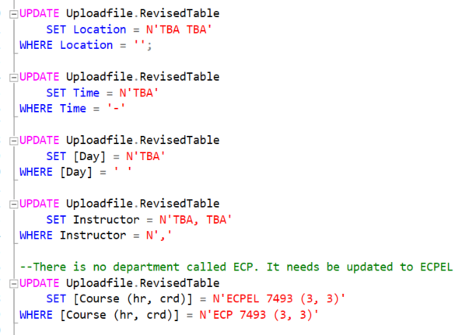
Data Cleansing

Slide 20
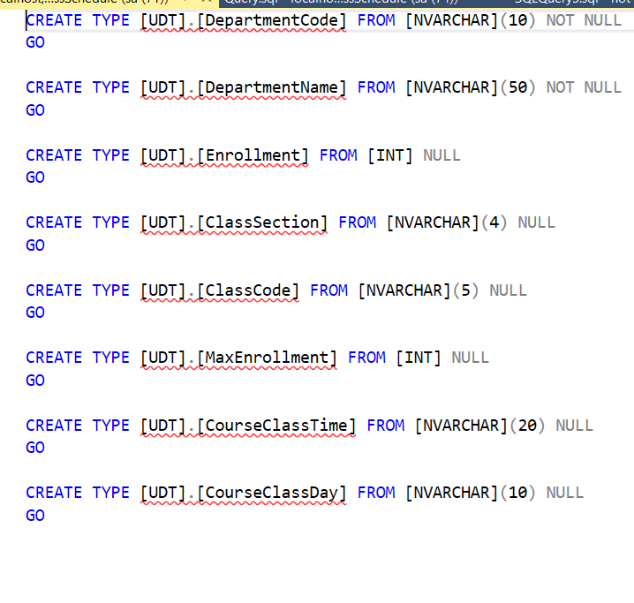
UDT (Department, Instructor, DepartmentInstructor, ClassDayTime, Class)

Slide 21
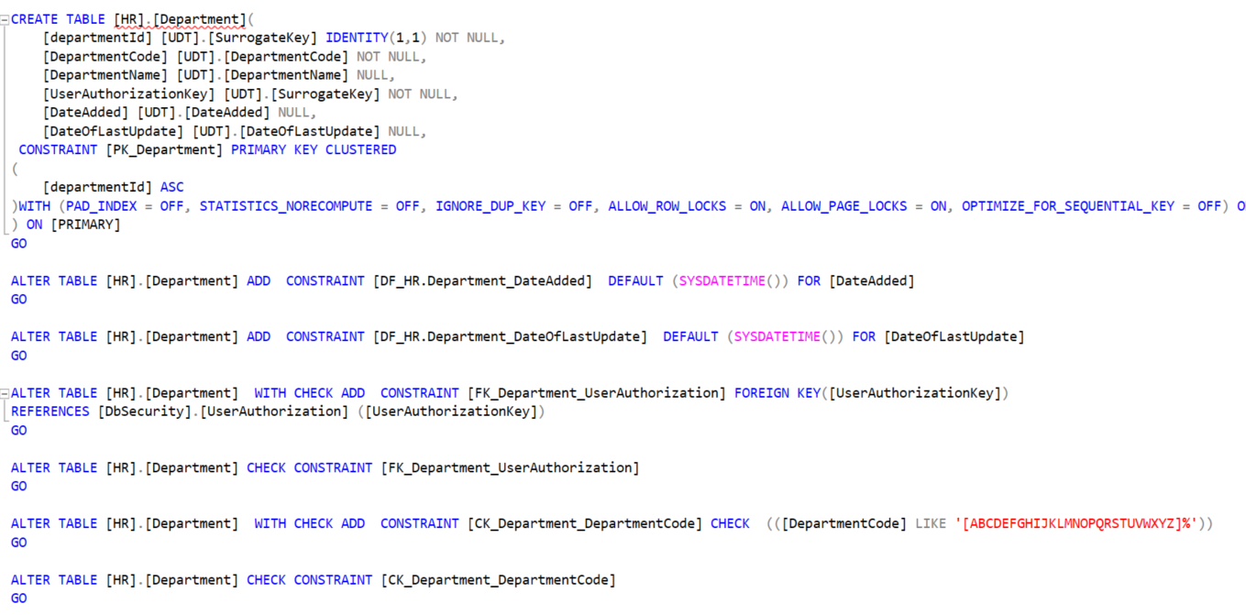
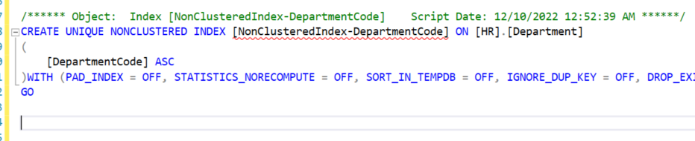
Department Table - Constraints

Slide 22
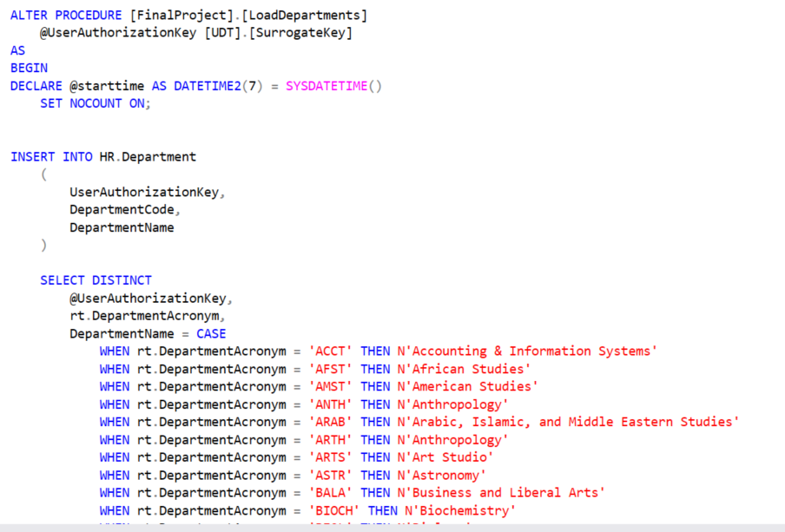
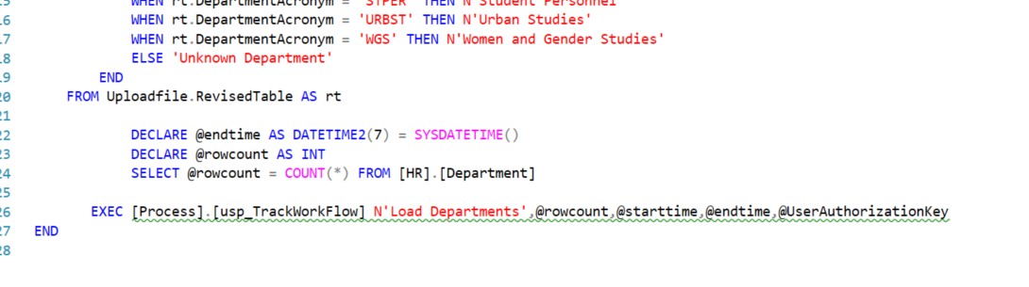

Slide 23
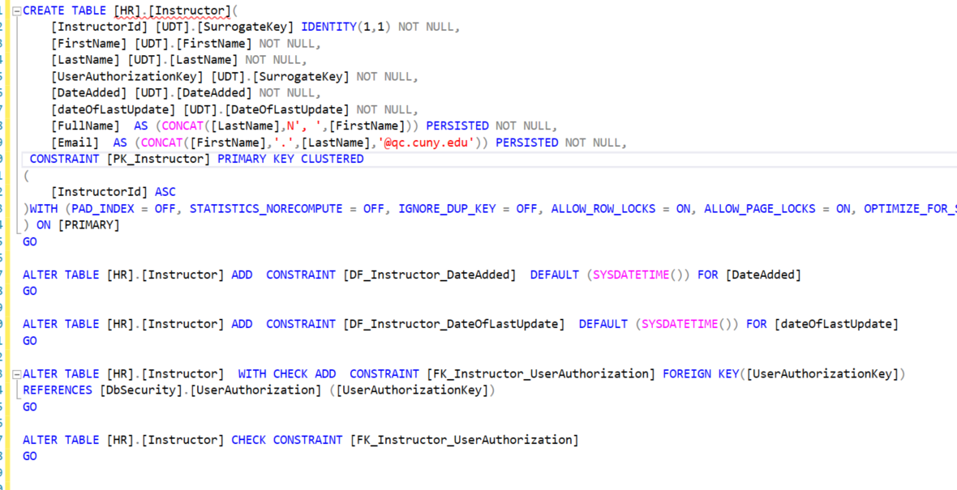
Instructor Table - Constraints

Slide 24
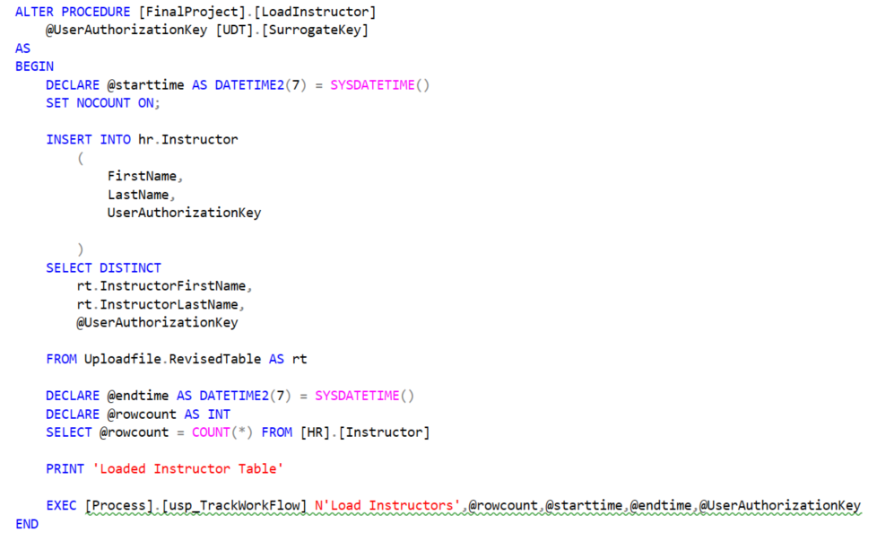
Load Instructor Table

Slide 25
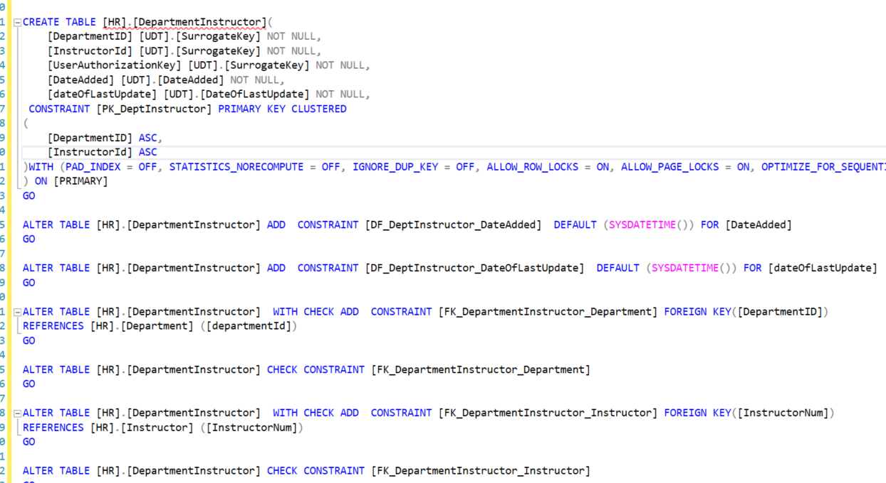
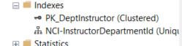
DepartmentInstructor Bridge Table - Constraints

Slide 26
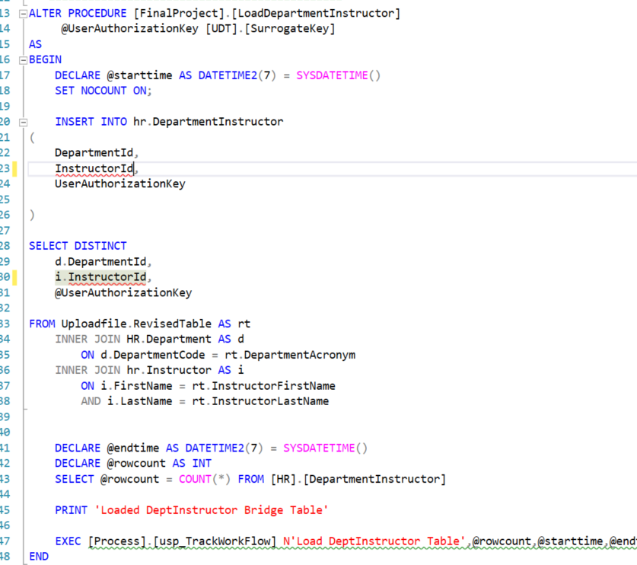

Slide 27
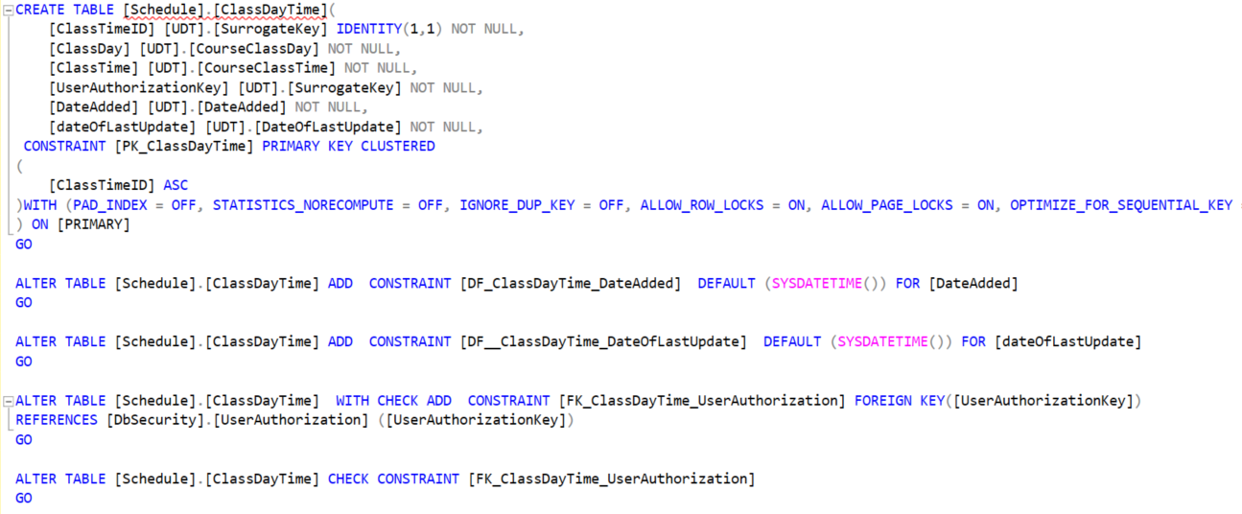
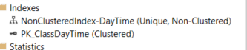
ClassDayTime Table- Constraints

Slide 28
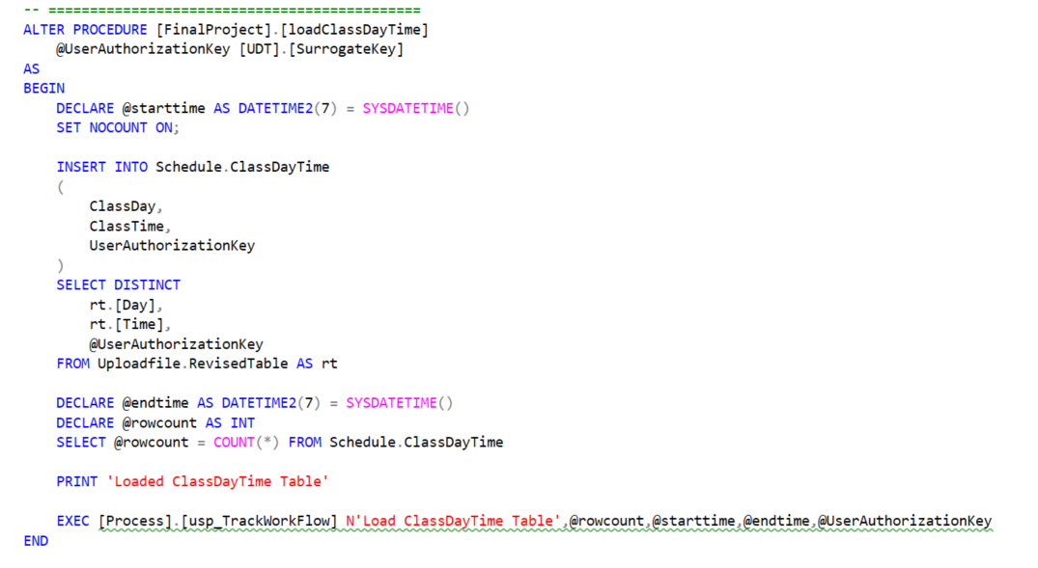
Load ClassDayTime Table

Slide 29
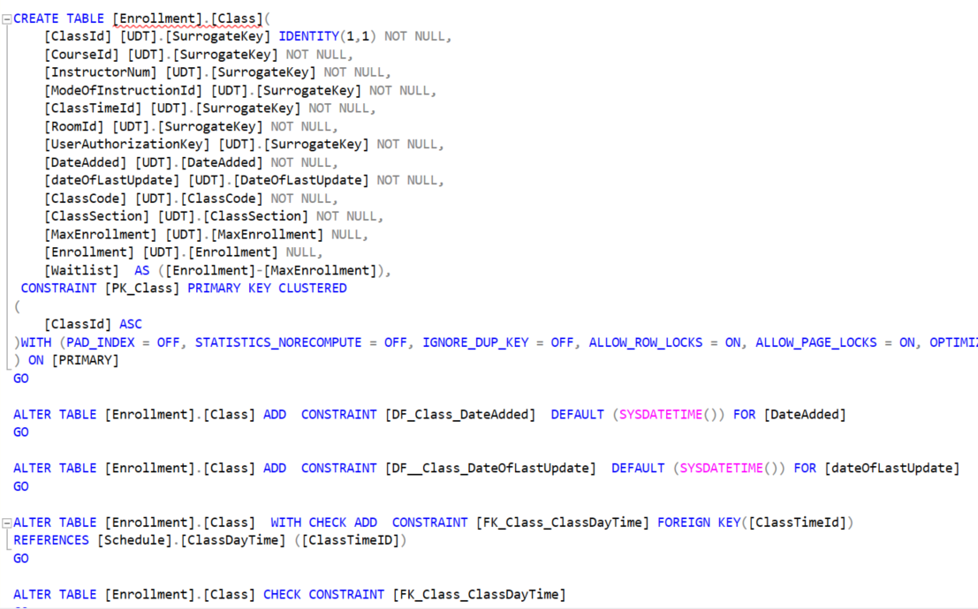
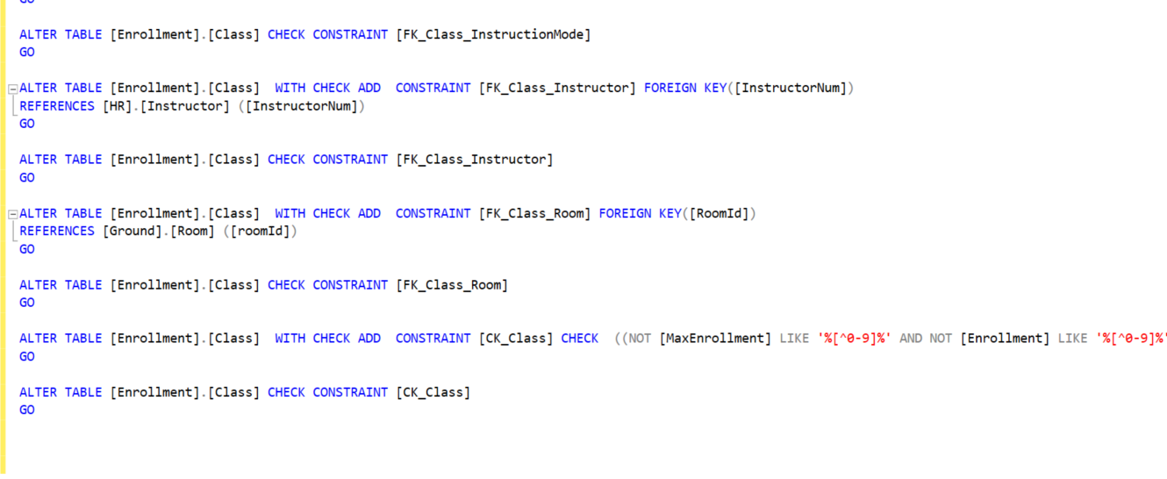
Class Table - Constraints

Slide 30
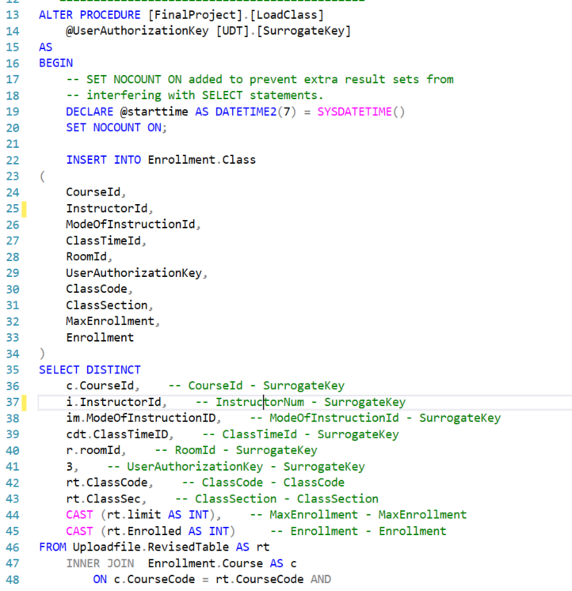
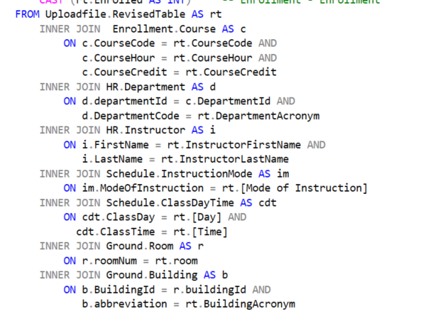
Load Class

Slide 31
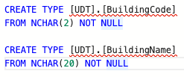
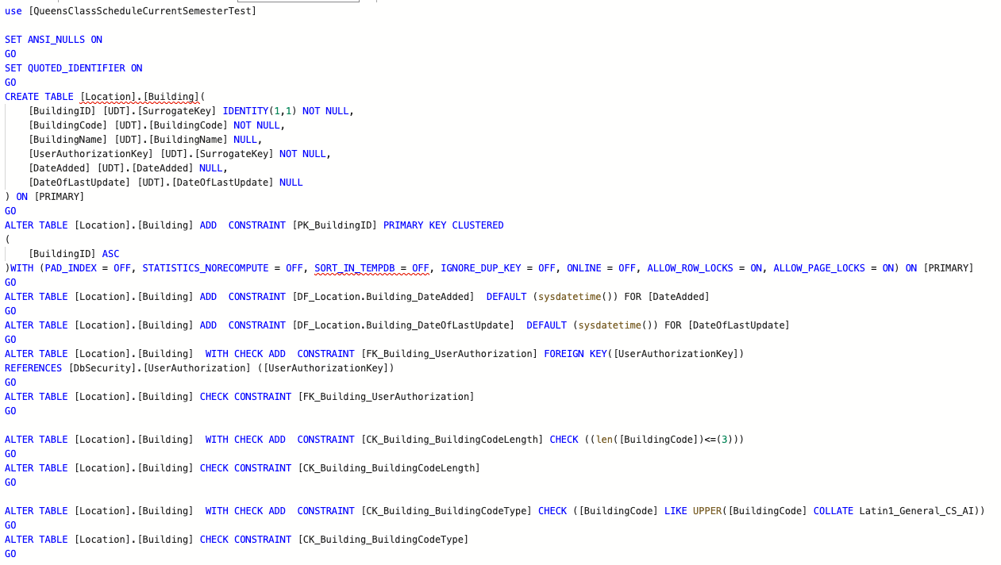
Building Table

Slide 32
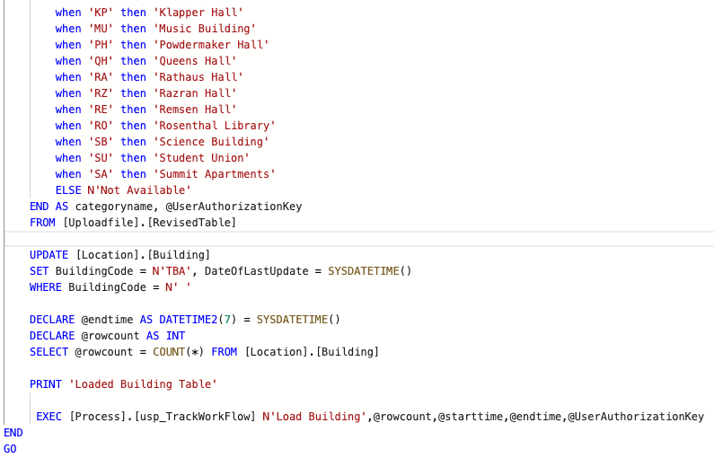
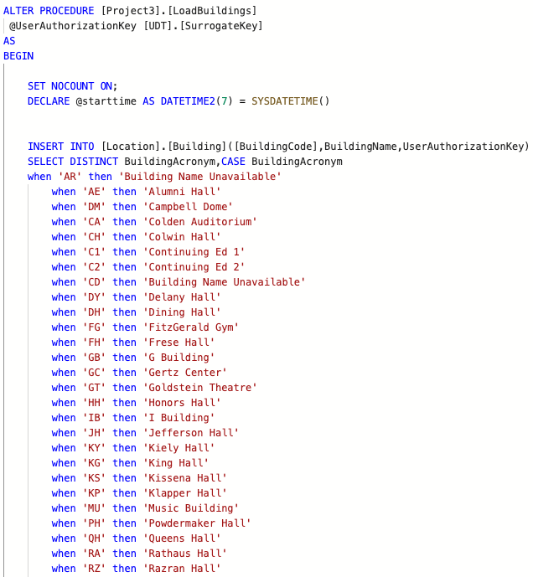
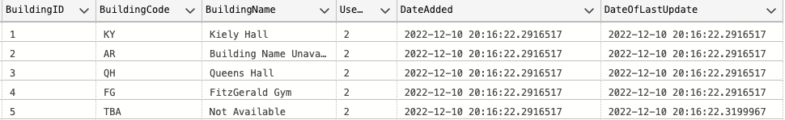
Load Building

Slide 33
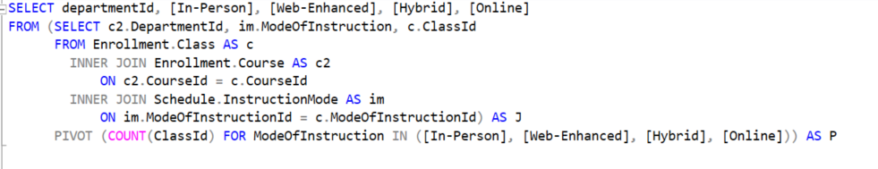
Proposition: Obtain a pivot table on how many of each mode of instruction are being offered by each department.

Slide 34
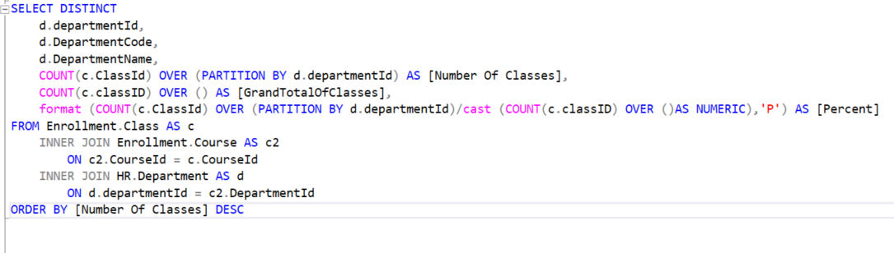
Proposition: How many classes are offered by each department? Obtain the percentage of the current value out of the grand total.

Slide 35
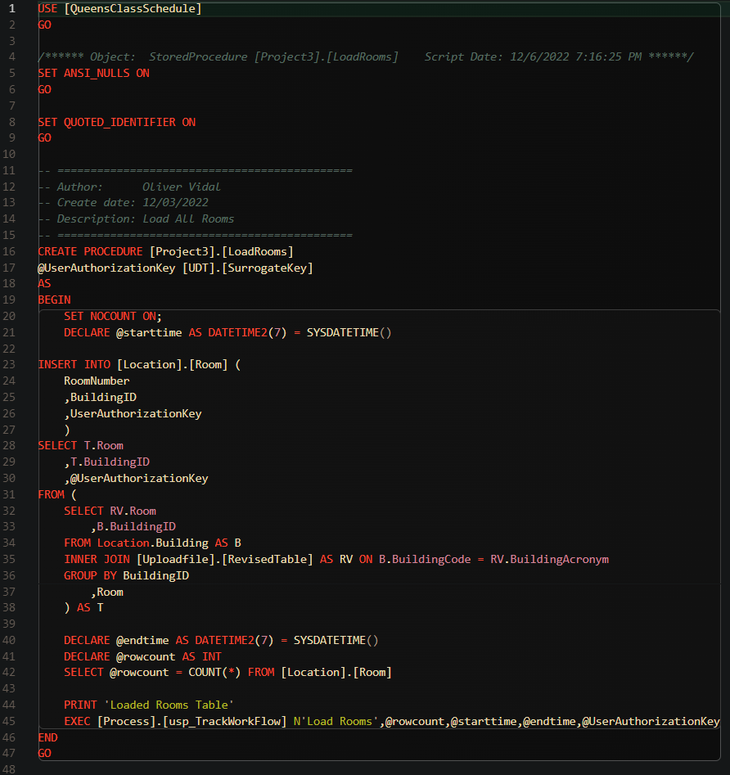
Load Procedure

Slide 36
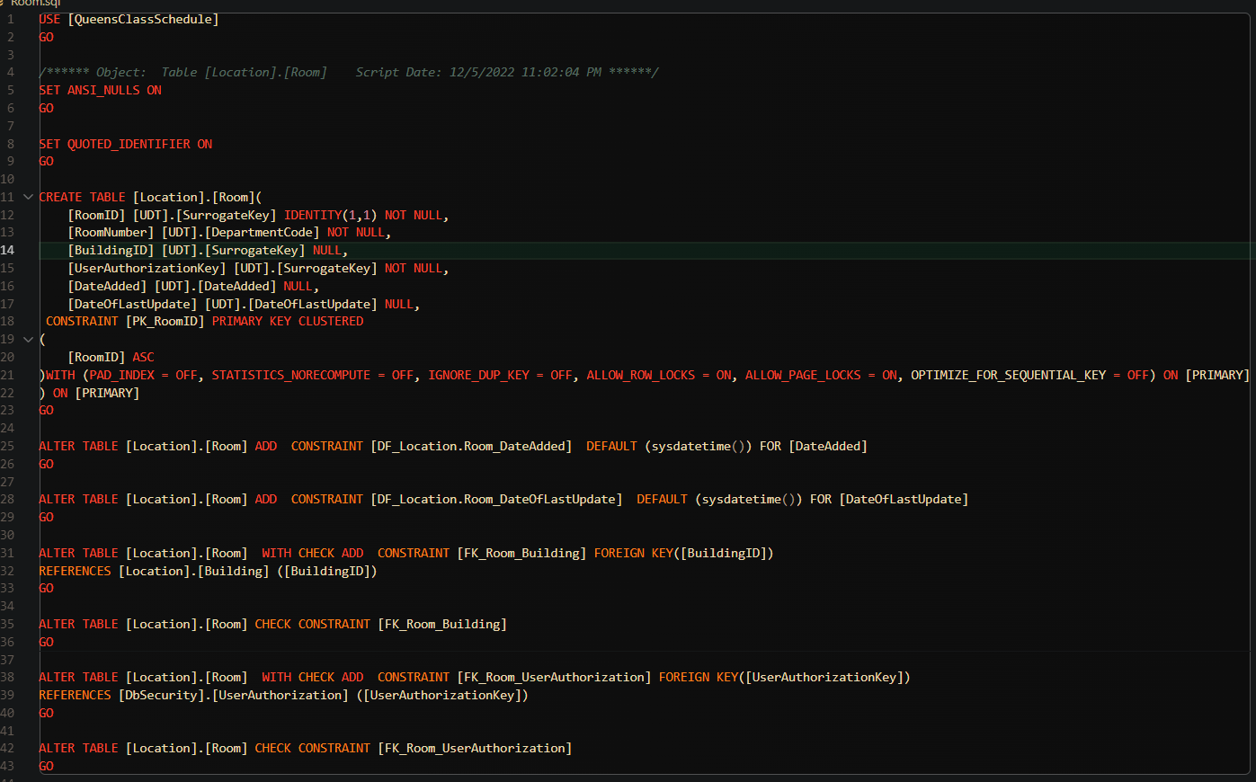
Room Table

Slide 37
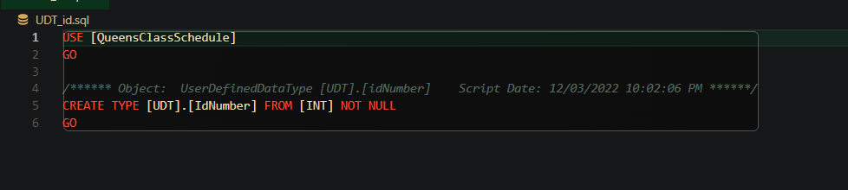
UDT Id Number

Slide 38
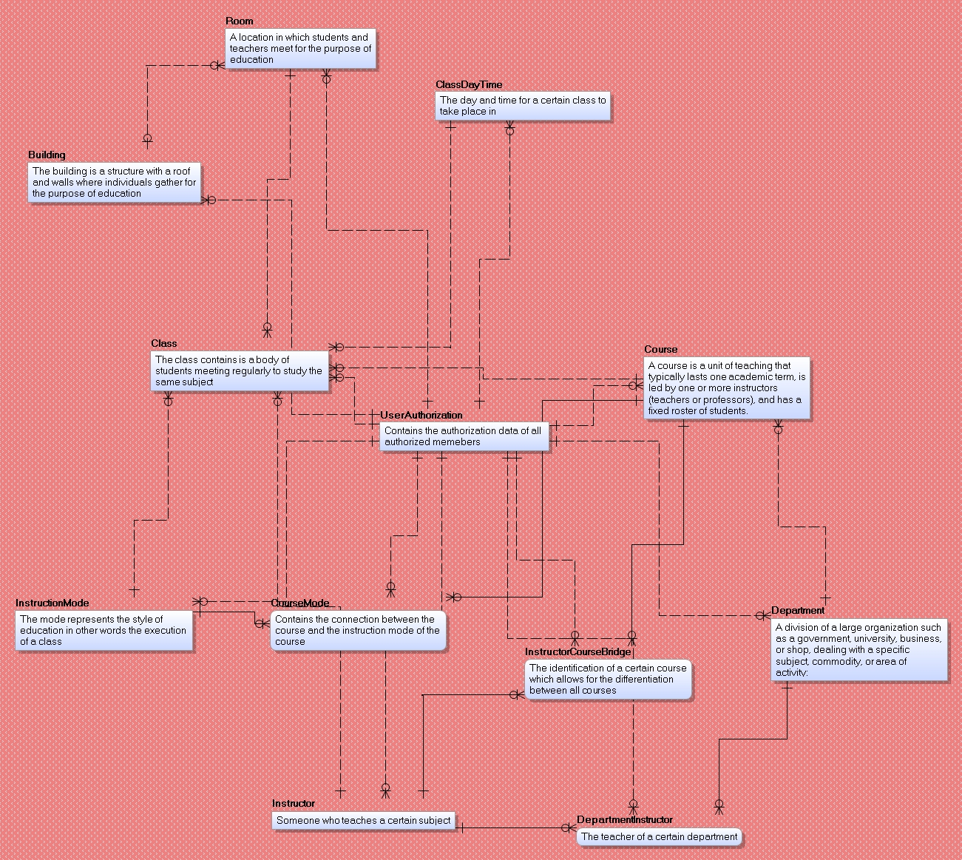
CDM

Slide 39
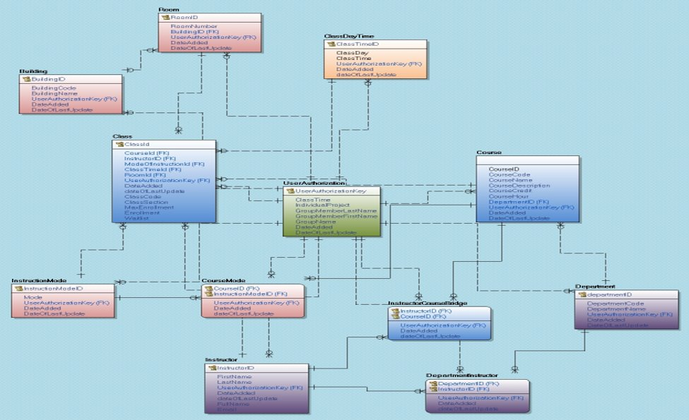
LDM

Slide 40
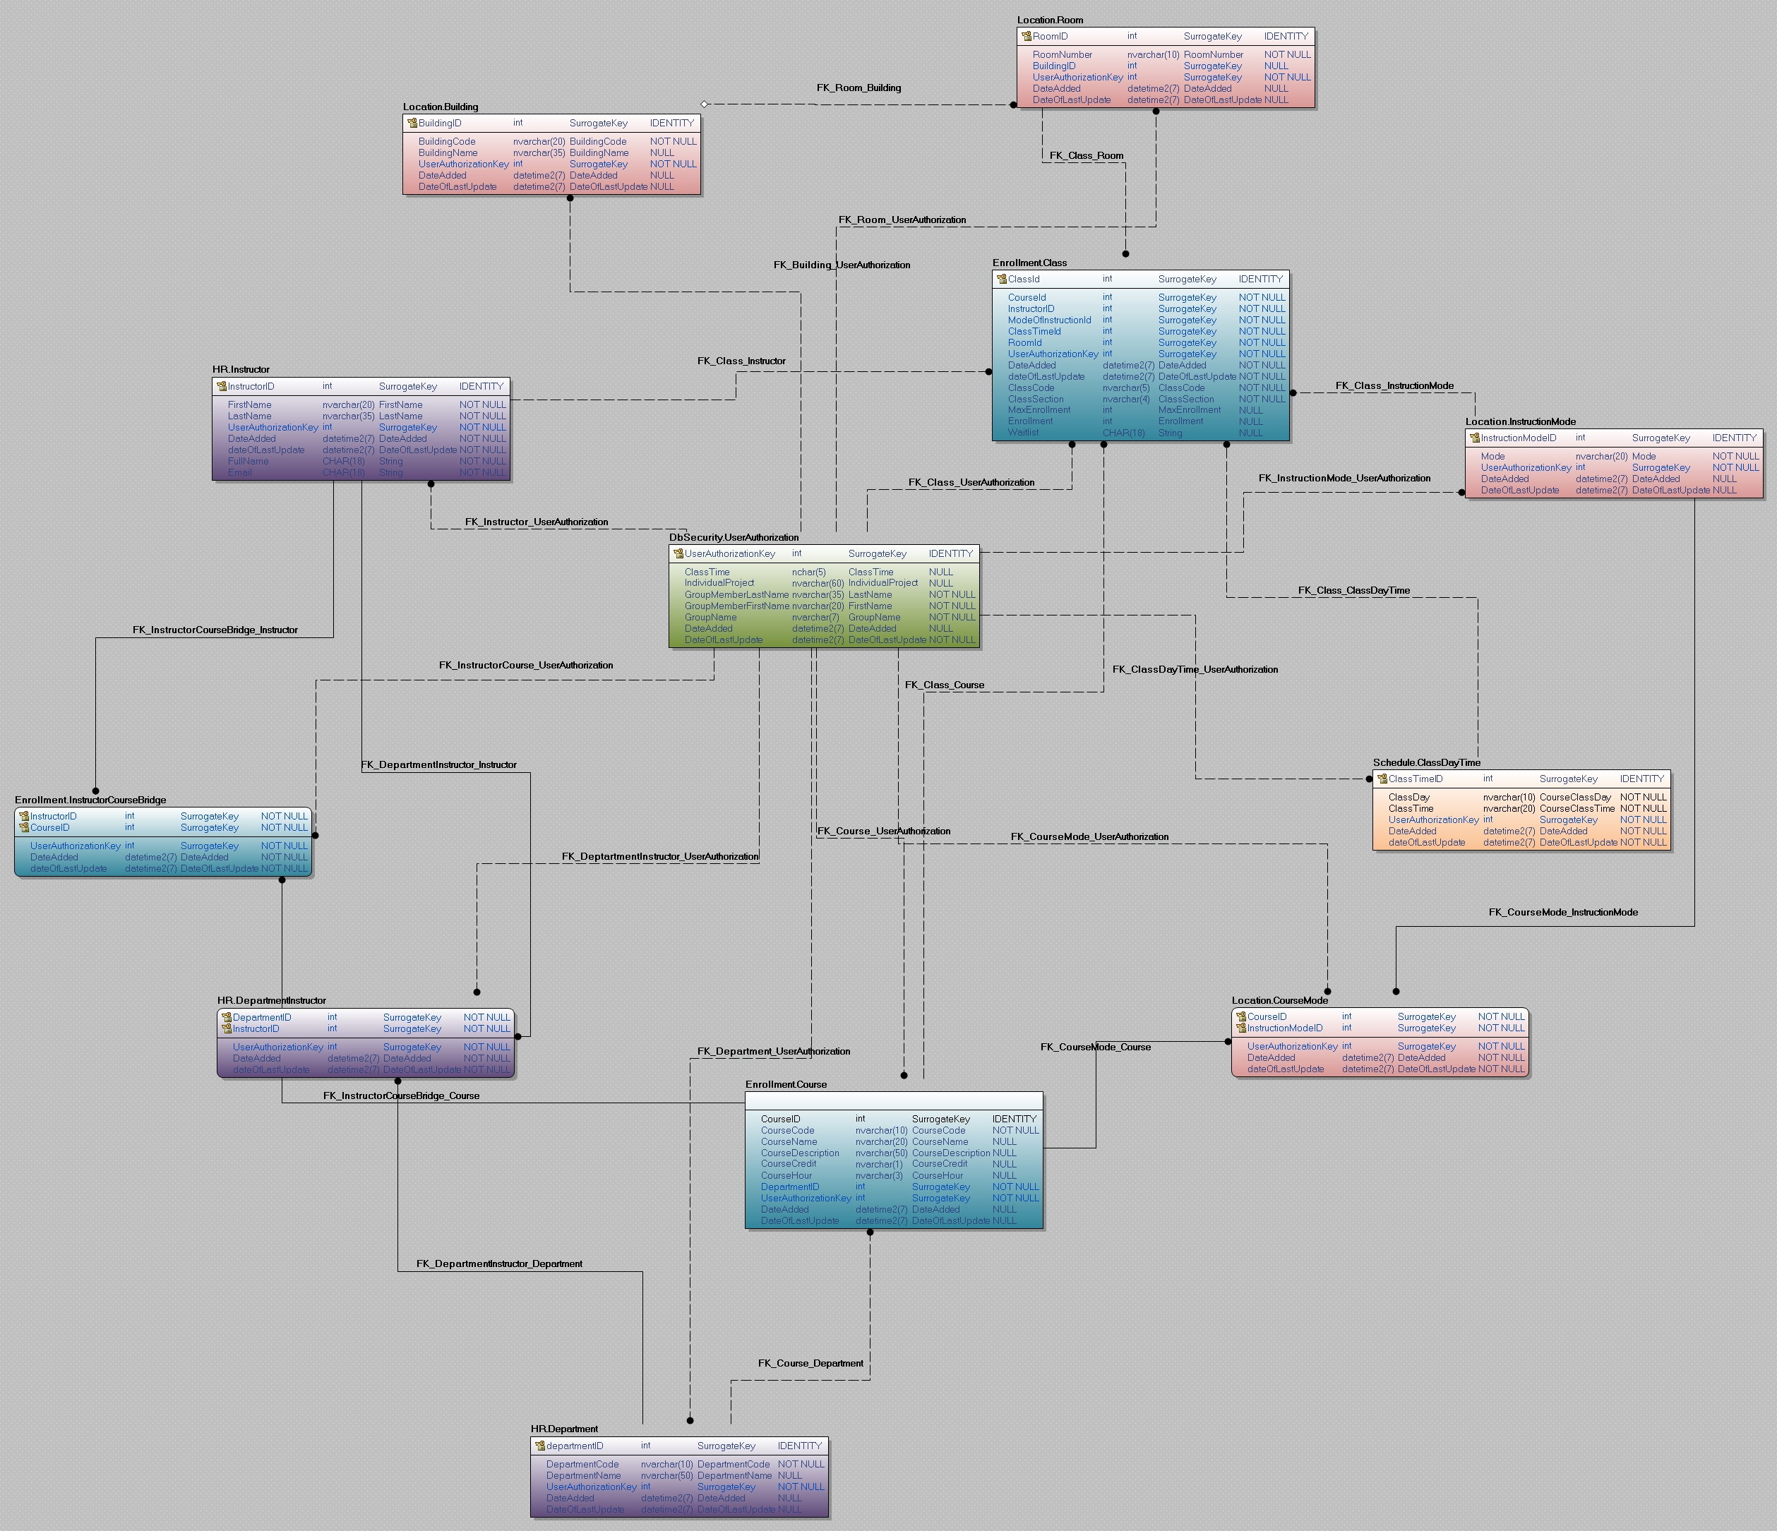
PDM

